Slide 1
Subject Name: Software Engineering
Subject Code: (BCSC-0009)
Topic Name: Software Engineering

Slide 2
Software
Programs
Documentation
Operating Procedure

Slide 3
Manuals in Documentation
All the requirements of the software are describe in detail.
Formal Specification
Analysis/Specification
It is drawn in order to define and clarify the boundaries
Context-Diagram
Data Flow Diagrams
It is drawn in order to define and clarify the boundaries
Flow Charts
Design
Entity-Relationship
Diagram
Documentation Manual
Implementation
Source Code Listings
Cross-Reference
Listing
The reference of the code module if it is being used in the software but has been developed by someone else.
Test Data
Testing
Test Results

Slide 4
Software Engineering
The term software engineering is the product of two words, software, and engineering.
The software is a collection of integrated programs.
Engineering is the application of scientific and practical knowledge to create, design and maintain processes.
It is a process of analyzing the requirements of user and then designing, building, and testing software application which will satisfy these requirements.

Slide 5
IEEE Definition of Software Engineering
Software engineering as the application of a systematic, disciplined, which is a computable approach for the development, operation, and maintenance of software.

Slide 6
Boehm’s Definition of Software Engineering
The practical application of scientific knowledge to the creative design and building of computer programs.
It also includes associated documentation needed for developing, operating, and maintaining them.

Slide 7
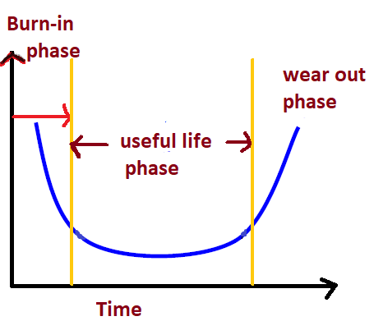

Characteristics of Software
Software Does not wear out

Slide 8
Characteristics of Software
Portability
A set of attributes that bears on the ability of the software to be transferred from one environment to another, without or minimum changes.

Slide 9
Software Failure
If there is any bug or any error in a program or a system then we will get incorrect or unpredicted result.
Due to error the behave of system will be inappropriate.

Slide 10
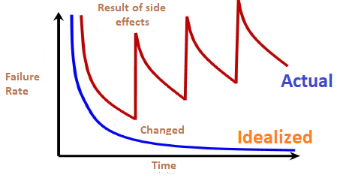
Failure Curve of Software

Slide 11
Open Source Software
Software in which source code is available is known as Open Source Software.
Ex: PHP, Linux, MySQL etc.

Slide 12
Need of Software Engineering
Reduce Complexities
Software engineering divides big problems into various small issues and then start solving each small problem one by one.

Slide 13
Need of Software Engineering(cont..)
DecreaseTime
Anything that is not made according to the project always wastes time.
And if you are making software/application, then you may need to run many codes to get final running code.
if you are making your software according to the software engineering method, then it will decrease a lot of time.

Slide 14
Characteristics of Software
Functionality
It refers to the degree of performance of the software against its intended purpose. It basically means are the required functions.

Slide 15
Characteristics of Software
Reliability
A set of attribute that Bear on the capability of software to maintain its level of performances understated conditions for a stated period of time.

Slide 16
Characteristics of Software
Efficiency
It refers to the ability of the software to use System Resources in the most Effective and Efficient Manner. The software should make effective use of storage space and executive commands as per desired timing requirement.

Slide 17
Characteristics of Software
Usability
It refers to the extent to which the software can be used with ease. Or the amount of effort or time required to learn how to use the software should be less.

Slide 18
Characteristics of Software
Maintainability
Refers to the ease with which the modifications can be made in a software system to extend its functionality, improvement, performance or correct errors.

Slide 19
Characteristics of Software
Portability
A set of attributes that bears on the ability of the software to be transferred from one environment to another, without or minimum changes.

Slide 20
Software Failure
If there is any bug or any error in a program or a system then we will get incorrect or unpredicted result.
Due to error the behave of system will be inappropriate.

Slide 21
Program
Program can be defined as the set of instruction, that perform specific task.
Actually, program is developed by an individual or a group of programmers for their own use.
Further classification of a program is not possible.
There is no need to use SDLC(Software Development life cycle in program).
There is no need of well defined/dedicated user interface in program.

Slide 22
Software
Software is a collection of programs.
There may be bundles of programs and data files in software.
There is need to use SDLC(Software Development life cycle) in software.
There is a well defined/dedicated user interface in software.

Slide 23
Software(cont..)
Further software is classified into two categories
Software
System Software
e.g-window
Application Software
e.g-MS-Office

